Slide 1



SMART AGRICULTURE
Submitted to: PROF. PAO-ANN HSIUNG.
GROUP-2

Slide 2
GROUP MEMBERS
SL NO. | STUDENT ID | NAME
1 | 10624402 | SHASHWATA MUKHERJEE
2 | 10624403 | BEDABRATA BORA
3 | 10624413 | PRAKHAR AWASTHI
4 | 10624414 | ADITYA GUPTA
5 | 10624417 | SHRAWANI SINGH
6 | 10624422 | PRIYANKA RAJ
7 | 10624445 | SATYAM SHAH
DEPARTMENT: COMPUTER SCIENCE AND
INFORMATION ENGINEERING.
NANHUA UNIVERSITY,TAIWAN

Slide 3
CONTENTS
1
INTRODUCTION
2
FUNCTIONS
3
PORTION DONE AND STILL ON PROCESS
4
WHAT WE GET TO LEARN IN THIS PROJECT?

Slide 4
PART ONE
INTRODUCTION

Slide 5
Internet of Things (IoT) plays a crucial role in smart agriculture.
Smart farming is an emerging concept, because IoT sensors capable of providing
information about their agriculture fields.
The collected data are analysed by experts and local farmers to draw suitable
conclusion on the various things that will be required for next week to a month etc.
We can take smart farming a step further by automating several parts of farming,
for example, smart irrigation and water management.
We can apply predictive algorithms on micro-controllers or SoC to calculate the amount
of water that will be required today for a particular agriculture field.

Slide 6
Say, if there was rain yesterday and the quantity of water required today is going to be less.
Similarly if humidity was high the evaporation of water at upper ground level is going to be less,
so water required will be less than normal, thus reducing water usage.
The project aims making use of evolving technology i.e. IoT and smart agriculture
using automation.
The feature of this project includes monitoring temperature, humidity and
moisture in agricultural field .
It will turn ON/OFF motor on the basis of favourable condition.

Slide 7
PART TWO
PORTION DONE AND STILL ON PROCESS

Slide 8
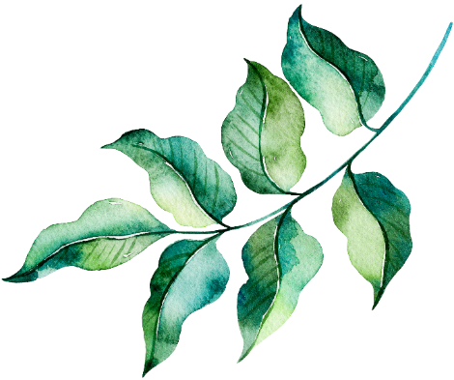



COMPLETE
Taking data from the sensors.
Sending the data to the Firebase website.
Displaying the retrieved data on the the app.
Calculating the amount of water required on the basis of the above data(temperature, light intensity and humidity)
INCOMPLETE
ML(Machine Learning) has been implemented but unfortunately integration is still on process.

Slide 9
PART THREE
FUNCTIONS

Slide 10
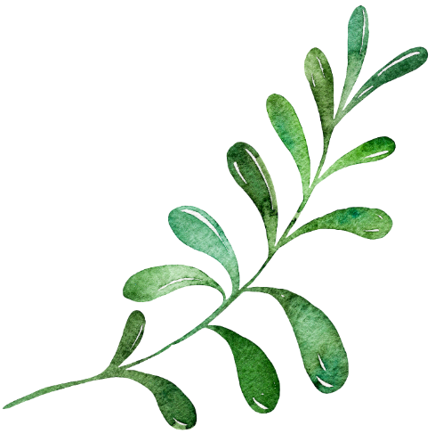
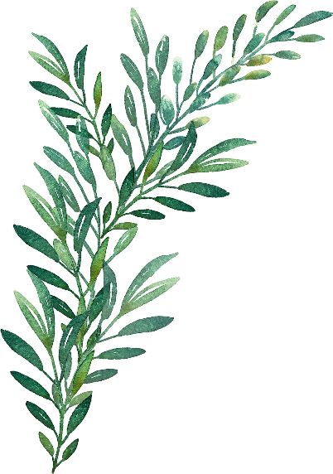
With the introduction of agriculture mankind entered upon a long period of meanness, misery, and madness, from which they are only now being freed by the beneficent operation of the machine.
It's the embrace of corn-based ethanol that has driven up all food prices. It's not making agriculture more sustainable.

Slide 11
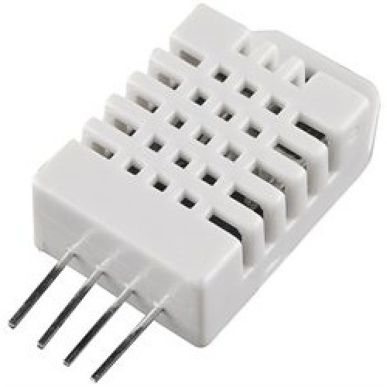
FUNCTION OF INDIVIDUAL COMPONENTS
1. SENSORS: It is used to send the data to the board after fixed interval of time.
The different types of sensors used in this projects are as follows:
Temperature and humidity sensor(DHT-22):

Slide 12
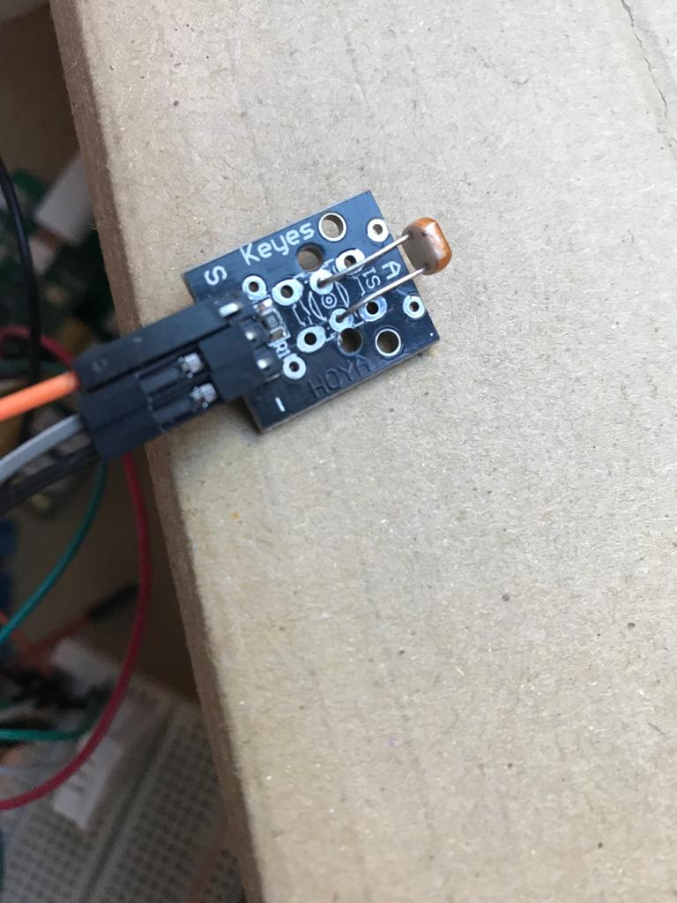
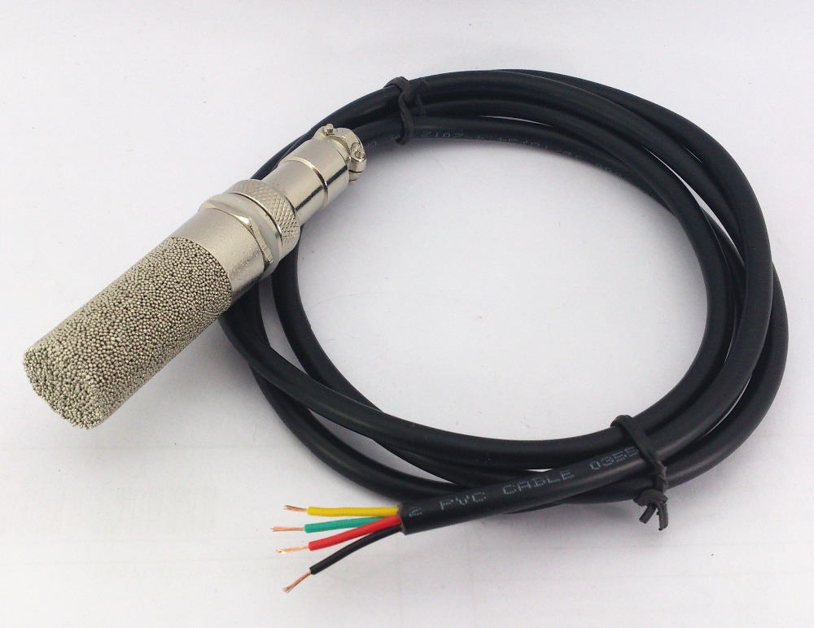
b) Light intensity sensor :
c) Moisture sensor:

Slide 13
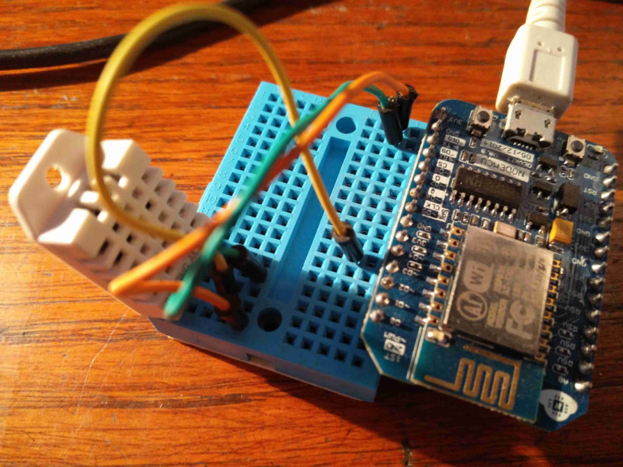
2. ESP-8266 BOARD:
The ESP8266 is a low-cost Wi-Fi microchip with full TCP/IP stack and microcontroller capability produced by manufacturer Espressif Systems in Shanghai, China. ... This small module allows microcontrollers to connect to a Wi-Fi network and make simple TCP/IP connections using Hayes-style commands.
Input: 16 GPIO pins
Type: 32-bit microcontroller
Manufacturer: Espressif Systems
Memory: 32 KiB instruction, 80 KiB user data

Slide 14
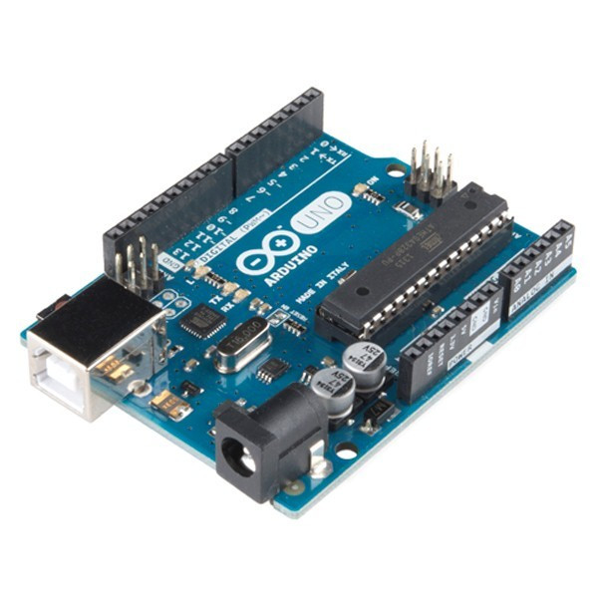
3. ARDUINO UNO:
The Arduino Uno is a microcontroller board based on the ATmega328. It has 20 digital input/output pins (of which 6 can be used as PWM outputs and 6 can be used as analog inputs), a 16 MHz resonator, a USB connection, a power jack, an in-circuit system programming (ICSP) header, and a reset button.

Slide 15
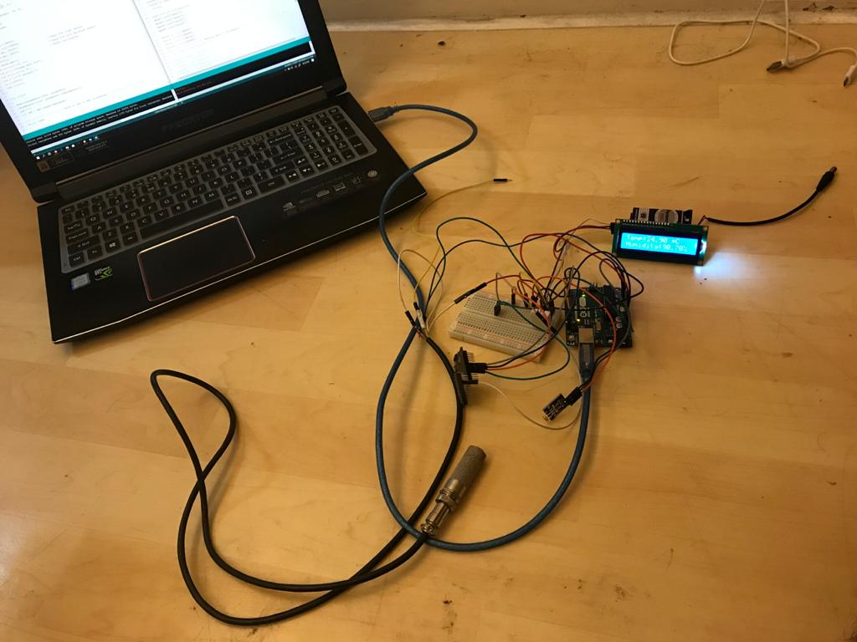
CIRCUIT DESIGN

Slide 16
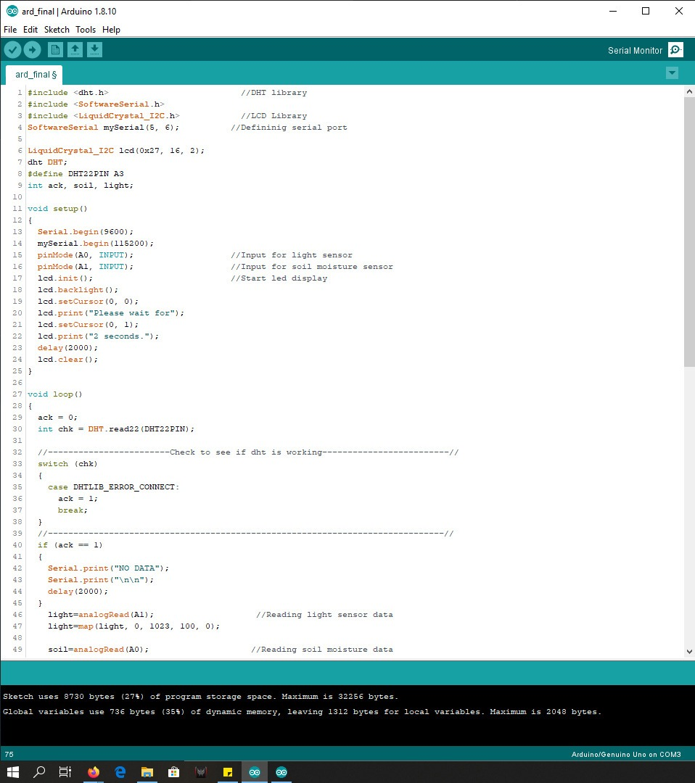
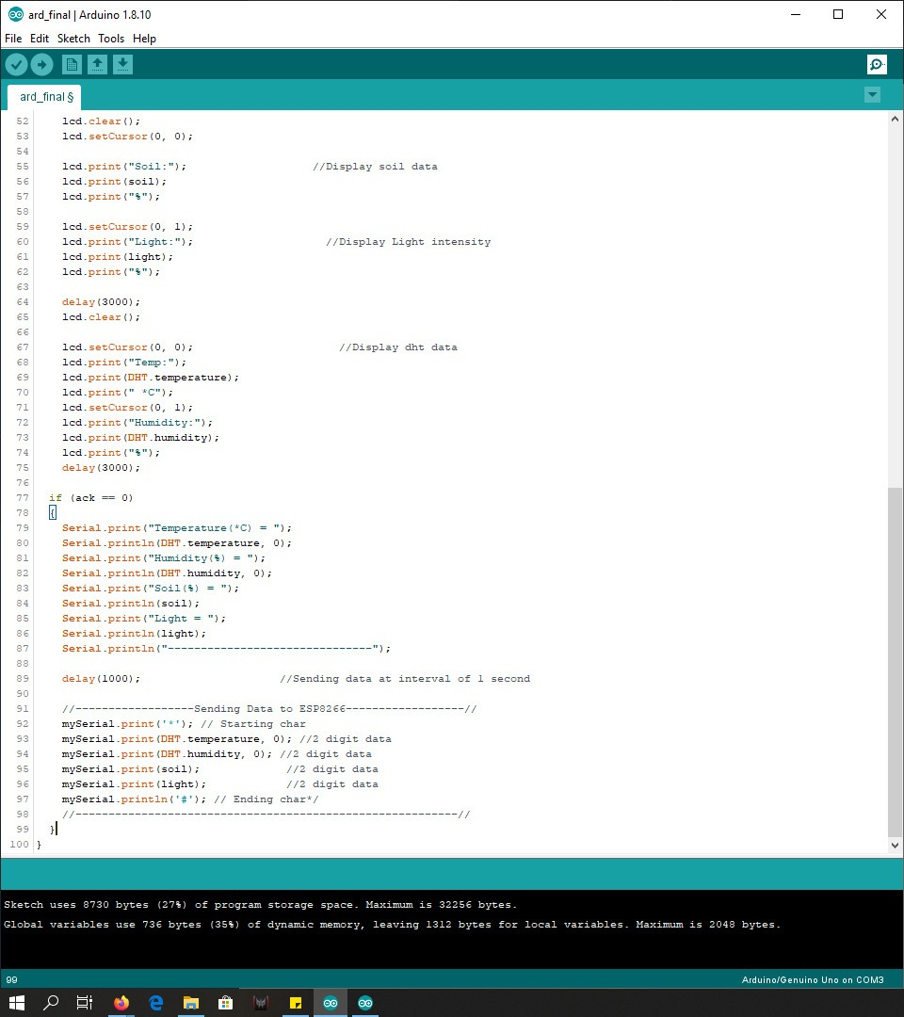
CODE SNIPPET FOR ARDUINO

Slide 17
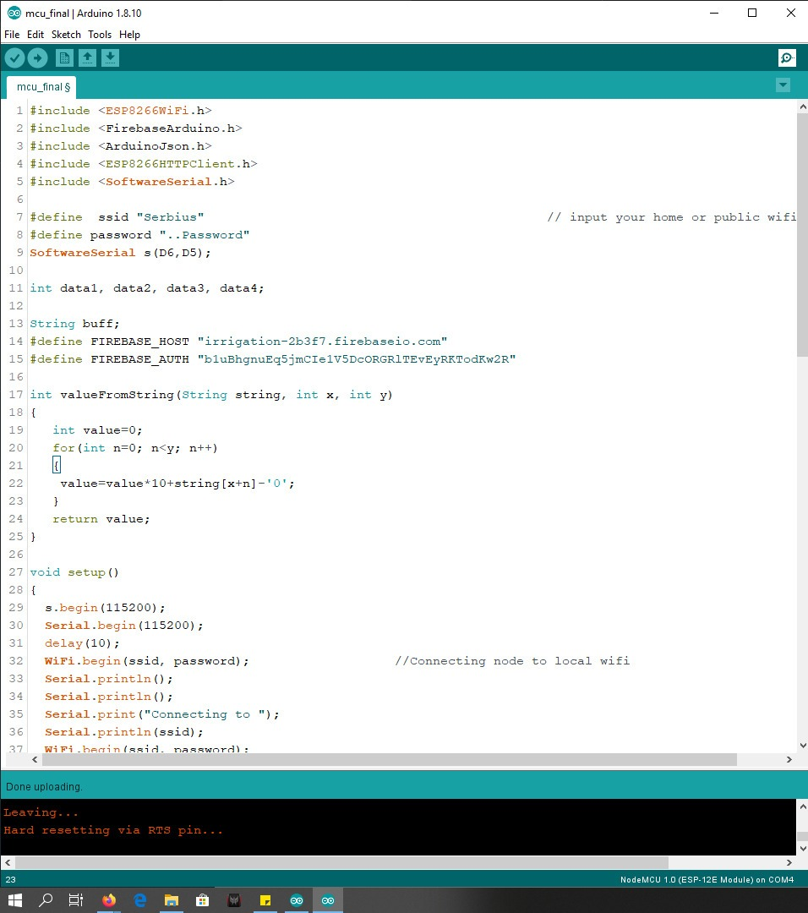
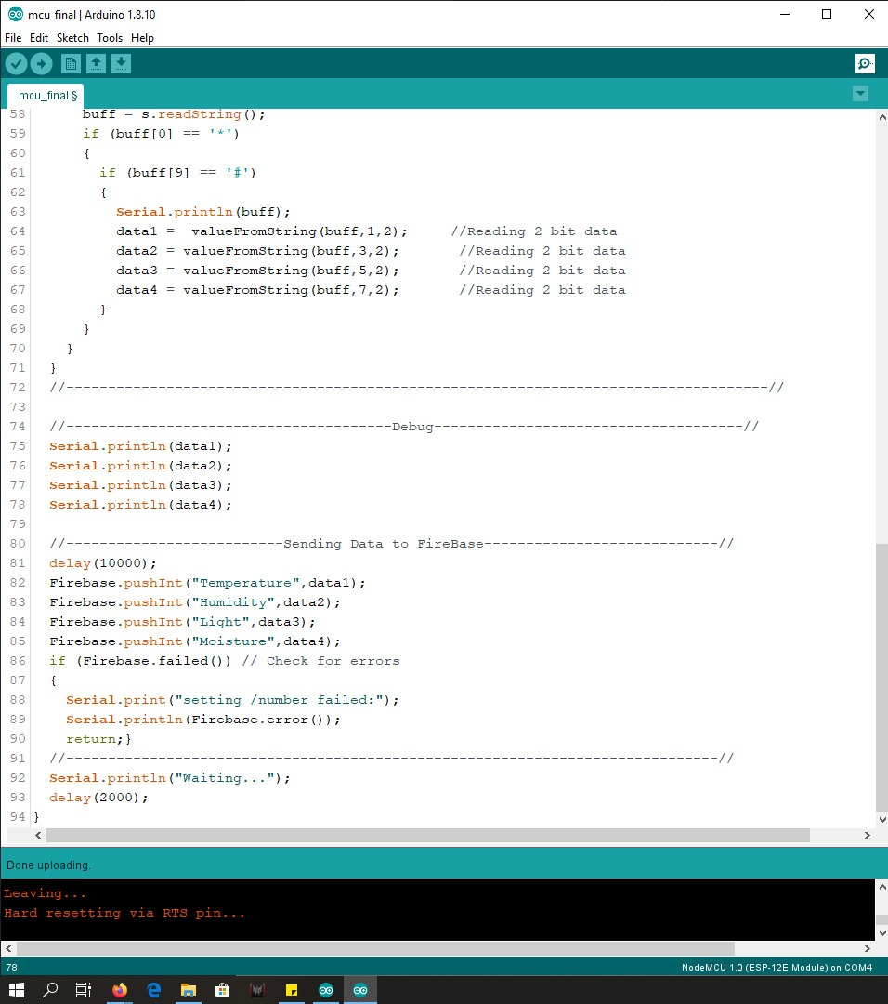
CODE SNIPPET FOR ESP-8266

Slide 18
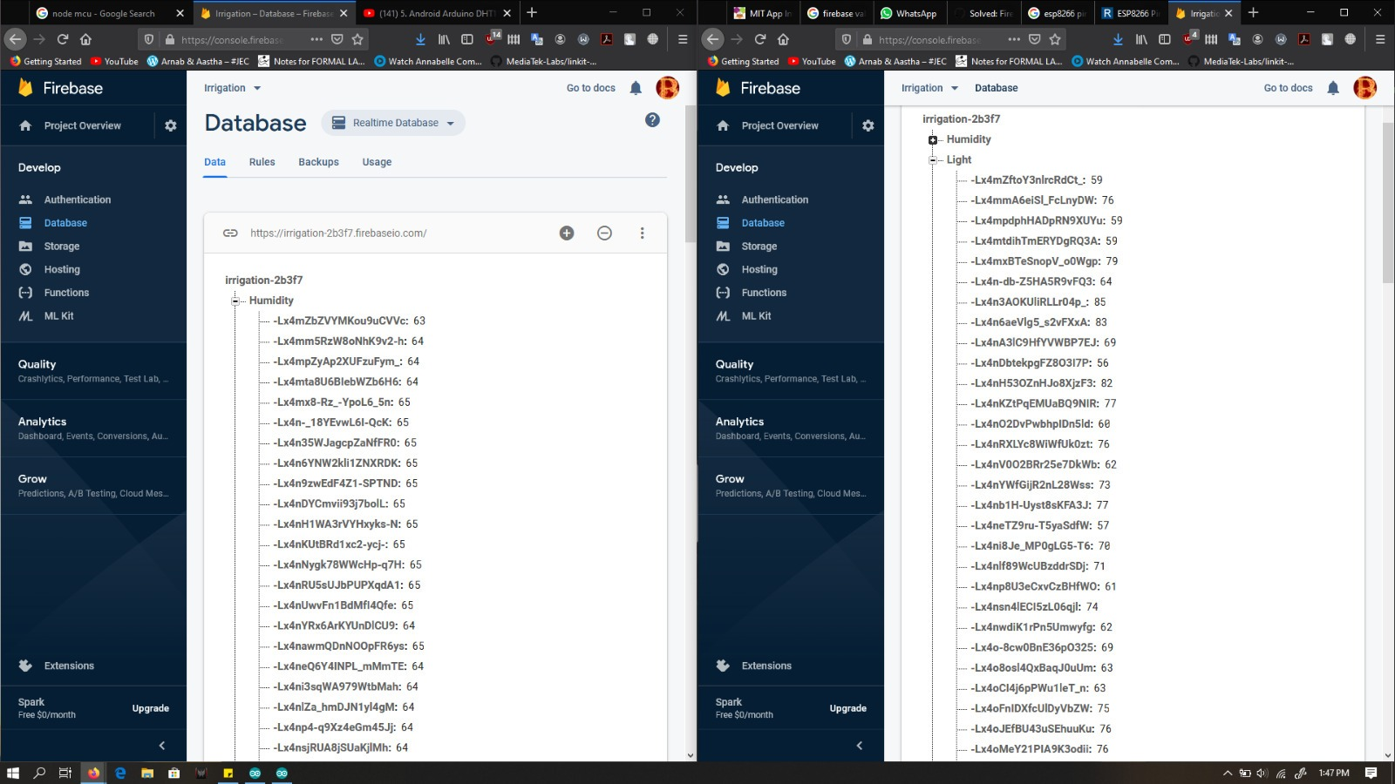
DATABASE

Slide 19
LIVE DEMO

Slide 20
PART FOUR
WHAT WE GET TO LEARN IN THIS PROJECT.

Slide 21
1. We learnt about different types of sensors and their working.
2. We learnt about many boards in the process which included ESP-8266,Adruino Uno and LinkIt 7697.
3. This project is incorporated into the LinkIt 7697 board after the failure of the ESP-8266 and Adruino Uno boards.
4. We explored different types of clouds use to store & manipulate data from the sensors E.g. thingspeak, aws (amazon web services), mcs (mediatek cloud sandbox).
5. Last but not the least, we learnt to integrate our project with the app and website.

Slide 22
THANKS FOR LISTENING

